Slide 1

The Professor Proposes
MCDA 5520 Team Project
Group Members: Caner Irfanoglu
Diven Sambhwani
Madeleine Leong
Sreeraj Punnoli
Tom Tong
December 4th, 2018

Slide 2

CONTENTS
01
02
03
Instruction & Problem Statement
Descriptive Analysis
Pre-work
04
05
06
Feature Engineering
Model Selection
Conclusion

Slide 3
Instruction & Problem Statement

Slide 4
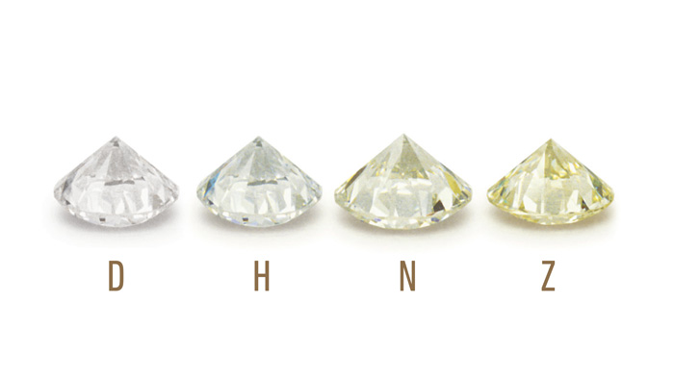
Color

Slide 5
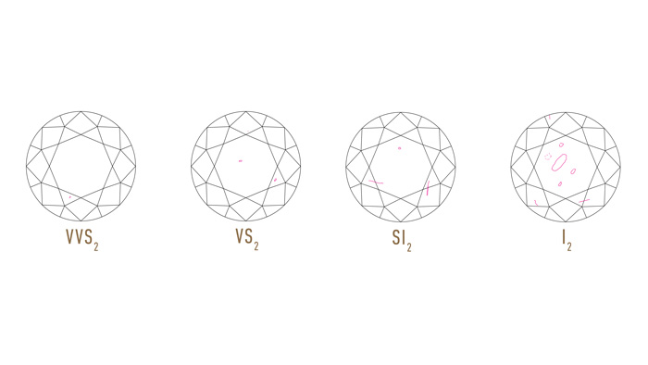
Clarity

Slide 6
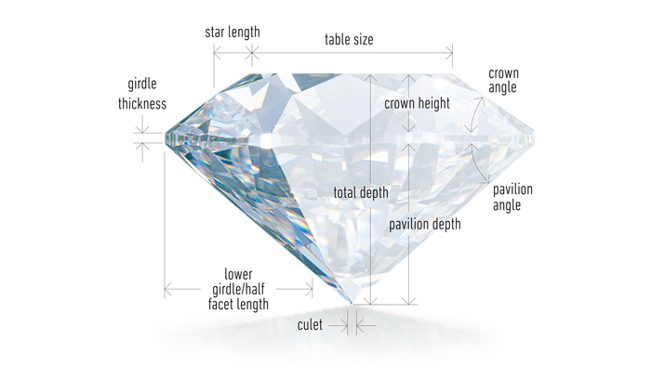
Cut

Slide 7
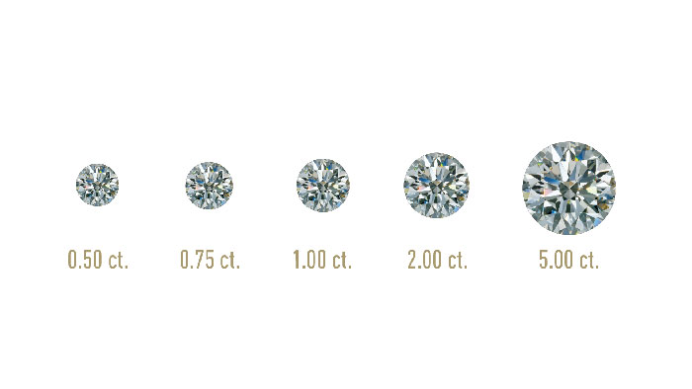
Carat

Slide 8
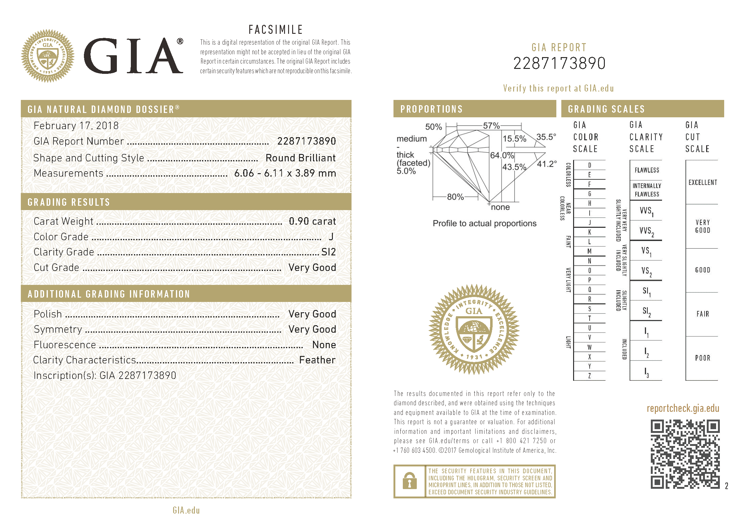
Problem Statement

Slide 9
Descriptive Analysis

Slide 10
Data Types of the Variables
Data
Categorical
Numerical
Ordinal
Nominal
Interval
Ratio
Clarity
Wholesaler
Carat
Color
Certification
Price
Polish
Symmetry
Cut

Slide 11
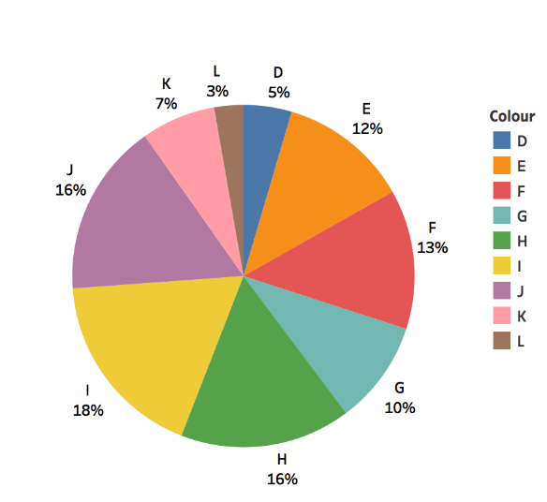
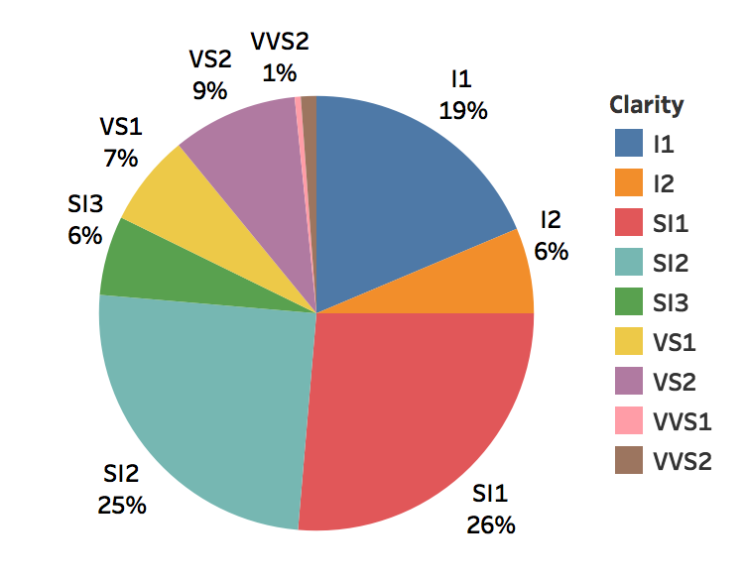
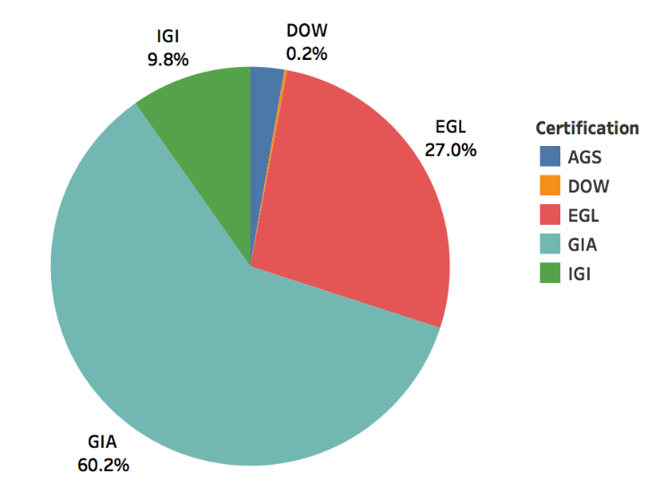
Descriptive Analysis
Distribution of Independent Variables – I
Color
Clarity
Certification

Slide 12
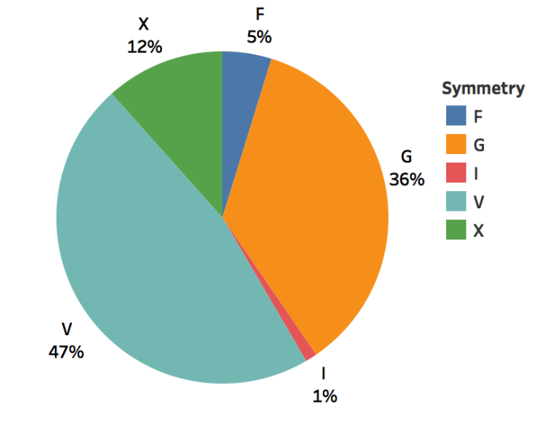
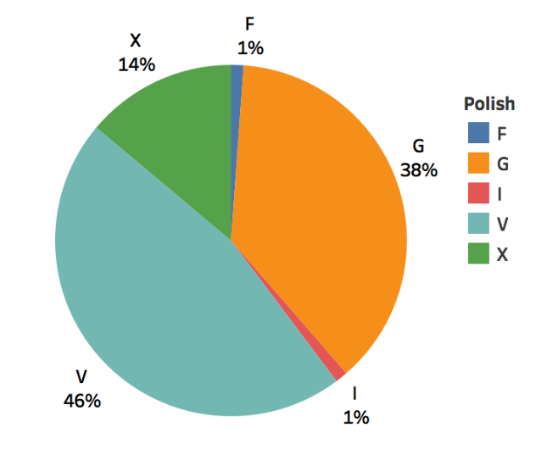
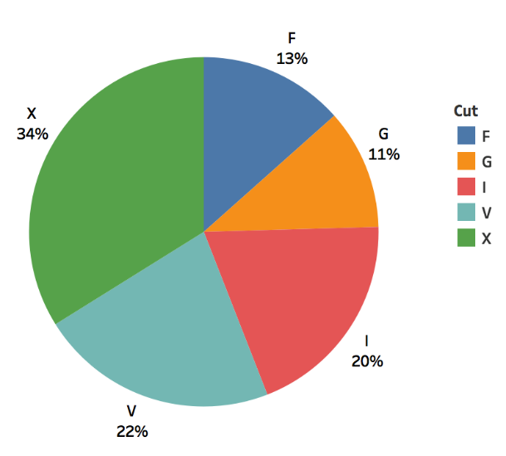
Descriptive Analysis
Distribution of Independent Variables – II
Symmetry
Polish
Cut

Slide 13
Descriptive Analysis
Density Distribution for Price

Slide 14
Descriptive Analysis
Density Distribution for Price

Slide 15
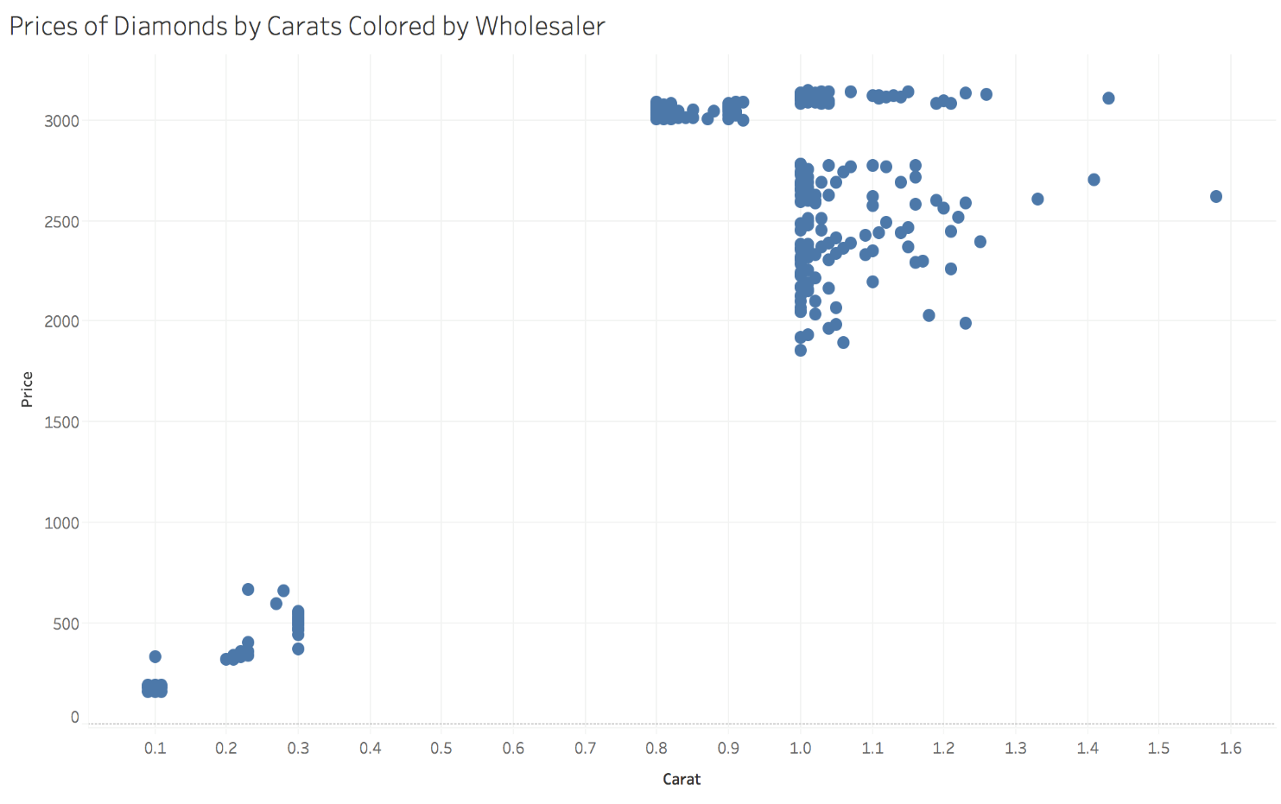
Descriptive Analysis
Bivariates: Price vs Carat

Slide 16
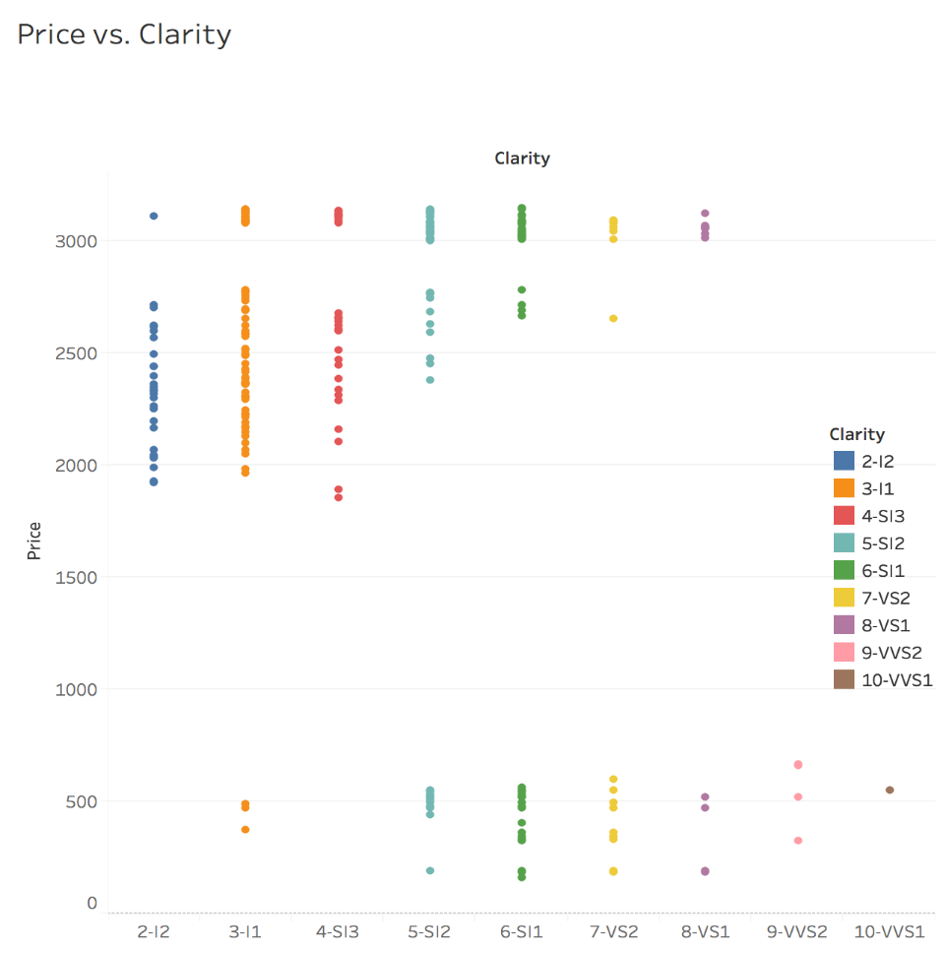
Descriptive Analysis
Bivariates: Price vs. Clarity

Slide 17
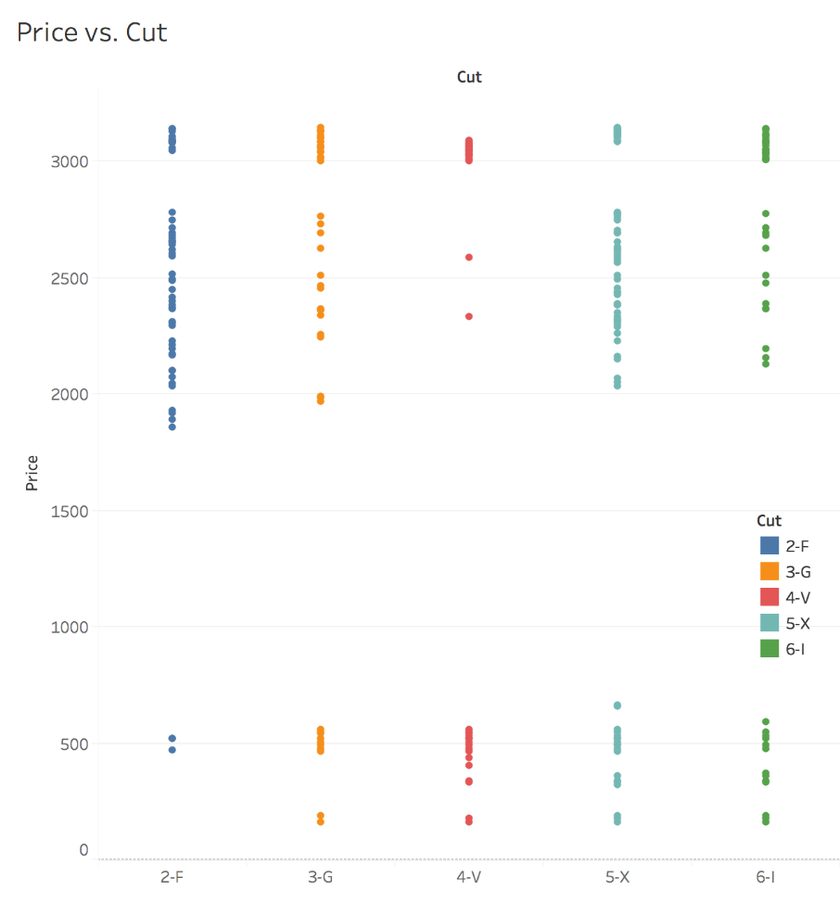
Descriptive Analysis
Bivariates: Price vs Cut

Slide 18
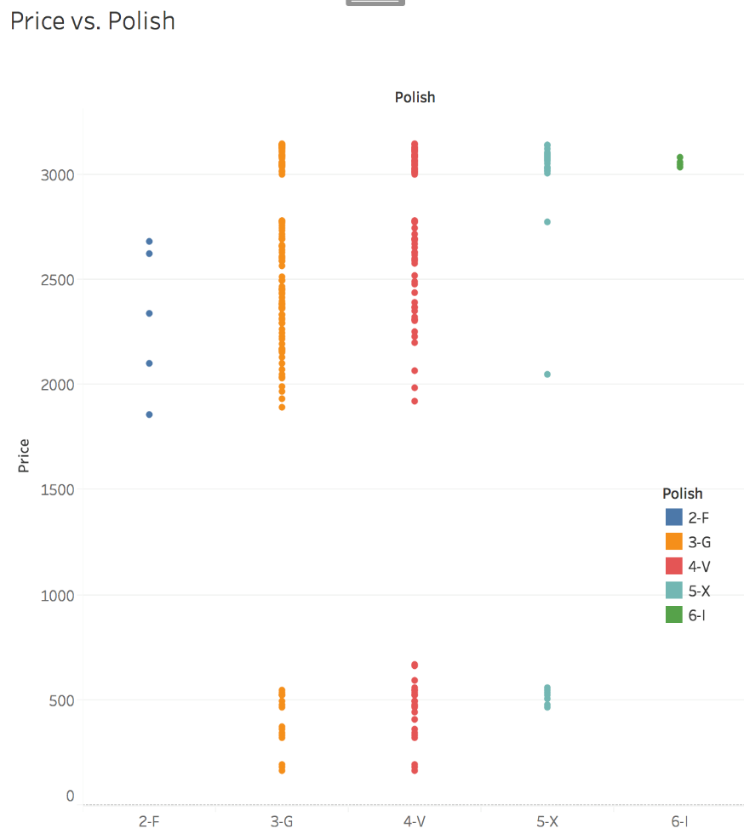
Descriptive Analysis
Bivariates: Price vs Polish

Slide 19
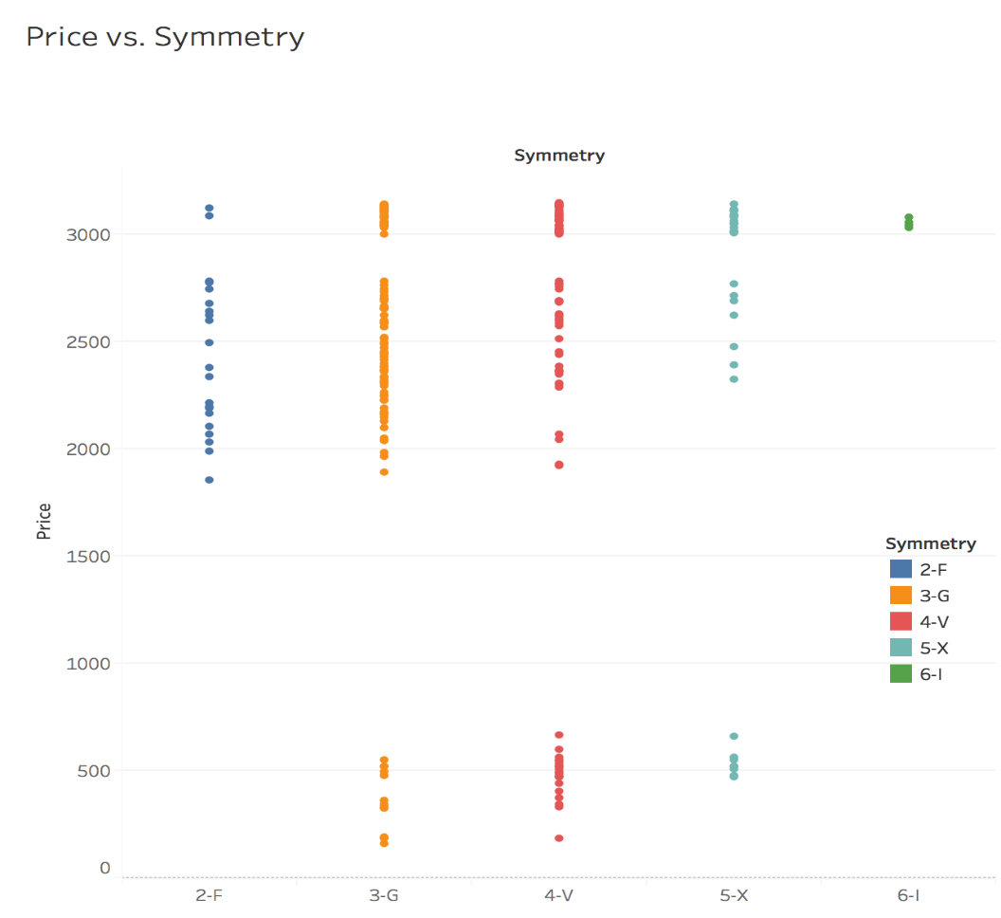
Descriptive Analysis
Bivariates: Price vs Symmetry

Slide 20
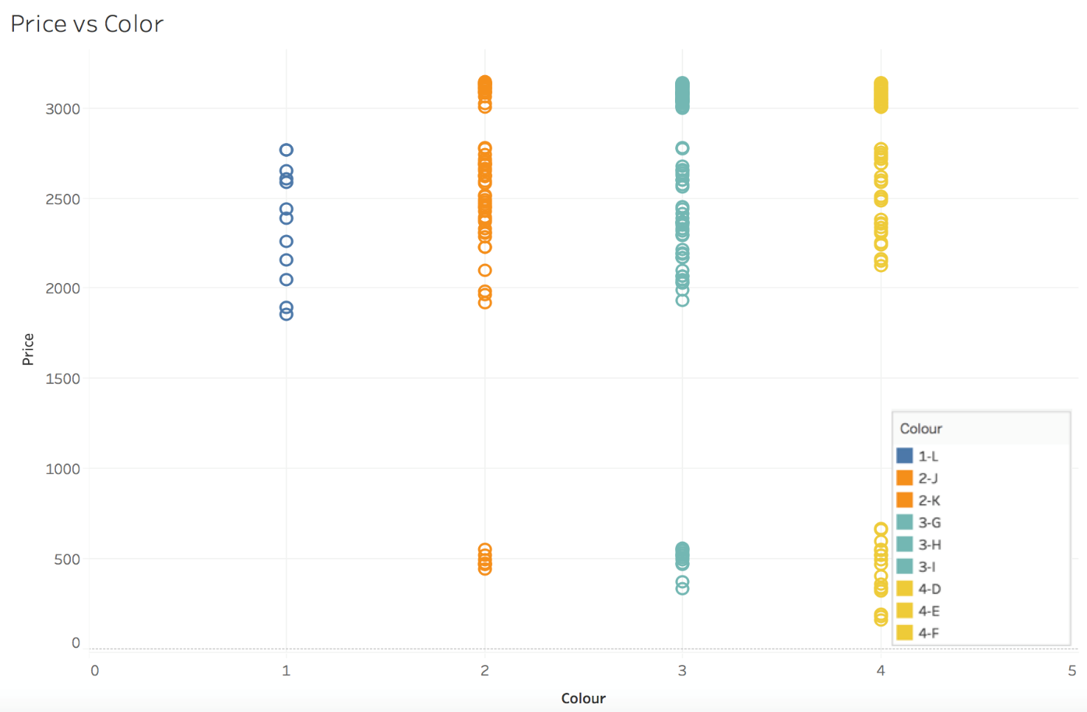
Descriptive Analysis
Bivariates: Price vs Color

Slide 21
Pre-work

Slide 22
Pre-work
ANOVA
Variable v/s Price | F-Value | Critical Value | P-Value
Cut | 17.94 | 2.41 | 0.000
Color | 5.32 | 3.88 | 0.021
Symmetry | 17.89 | 3.03 | 0.000
Polish | 18.14 | 3.03 | 0.000
Clarity | 42.64 | 3.03 | 0.000
Certification | 4.08 | 3.88 | 0.044

Slide 23
Pre-work
MULTICOLLINEARITY

Slide 24
Feature Engineering

Slide 25
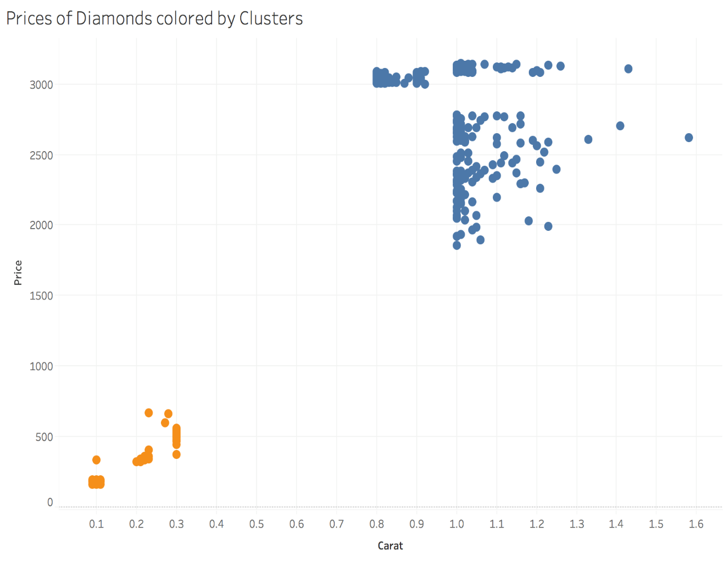
Why Performing Analysis on Blue Cluster
Carat is a significant predictor
Professor’s Diamond lies in the blue cluster
Using all available data may lead bias, since
Lower carat and Higher carat traits may differ
Most of the data for blue cluster lies between
0.8 - 1.3 carats, which is a relatively small interval Blue cluster is more favorable under linearity assumption (Carat vs. Price not linear for the whole carat range - as given in the pdf )

Slide 26
Feature Engineering Part I
Getting to know variables
Price is the prediction variable (Dependent)
Carat, Clarity, Color, Polish, Symmetry, Cut, Certification, Wholesaler are predictors (Independent variables)
Categorical Variable levels should be distinct based on their price prediction ability
Wholesaler needs to be excluded from prediction, since it is not a diamond characteristic (May introduce bias)

Slide 27
Feature Engineering Part II
Grouping Ordinal Variables by Predictive Ability
Clarity
Originally had 7 levels.
Grouped to 3 levels
Variable Name | Original Levels | Final Levels | Levelling Criteria(s) | Original R-squared | After ReGrouping R-squared
Clarity | I2 I1 SI3 SI2 SI1 VS2 VS1 | Flawed Naked Eye 10x Zoom Flaws 30x Zoom Flaws | Some Levels Insignificant for price | 0.403 | 0.265

Slide 28
Feature Engineering Part II
Grouping Ordinal Variables by Predictive Ability
Color
Variable Name | Original Levels | Final Levels | Levelling Criteria(s) | Original R-squared | After ReGrouping R-squared
Color | L J,K G,H,I F,D,E | Near Colorless Lightly Yellow | Some Levels Insignificant for price | 0.065 | 0.021

Slide 29
Feature Engineering Part II
Grouping Ordinal Variables by Predictive Ability
Polish
Variable Name | Original Levels | Final Levels | Levelling Criteria(s) | Original R-squared | After ReGrouping R-squared
Polish | F G V X I | F + G V X + I | Small sample size for F and I | 0.149 | 0.133

Slide 30
Feature Engineering Part II
Grouping Ordinal Variables by Predictive Ability
Symmetry
Variable Name | Original Levels | Final Levels | Levelling Criteria(s) | Original R-squared | After ReGrouping R-squared
Symmetry | F G V X I | F G V + X + I | Small sample size for I Low predictive ability difference between V-X | 0.141 | 0.133

Slide 31
Feature Engineering Part II
Grouping Ordinal Variables by Predictive Ability
Cut
Variable Name | Original Levels | Final Levels | Levelling Criteria(s) | Original R-squared | After ReGrouping R-squared
Cut | F G V X I | F G V X I | All levels distinct Bin Sizes are large enough | 0.144 | 0.144

Slide 32
Feature Engineering Part II
Grouping Ordinal Variables by Predictive Ability
Certification
Variable Name | Original Levels | Final Levels | Levelling Criteria(s) | Original R-squared | After ReGrouping R-squared
Certification | AGS GIA EGL DOW IGI | AGS + GIA EGL + DOW + IGI | Two most respected labs vs. others | 0.082 | 0.054

Slide 33
Model Selection

Slide 34
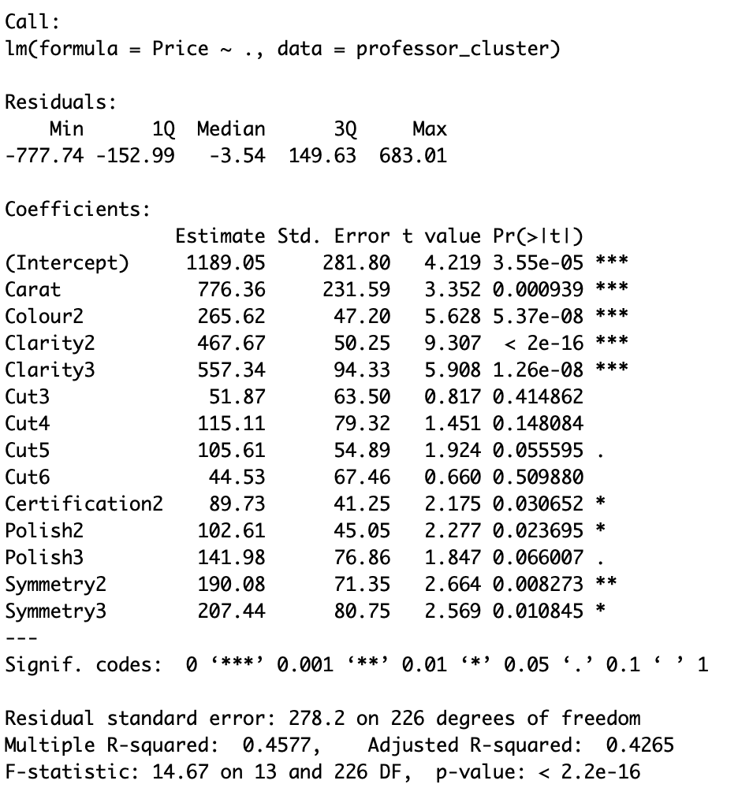
Model Selection
Variable Selection
Step 1: Construct a model with all independent variables
Regroup Cut into 2 groups
Fair, Good = 1
Very Good, Exceptional, Ideal = 2

Slide 35
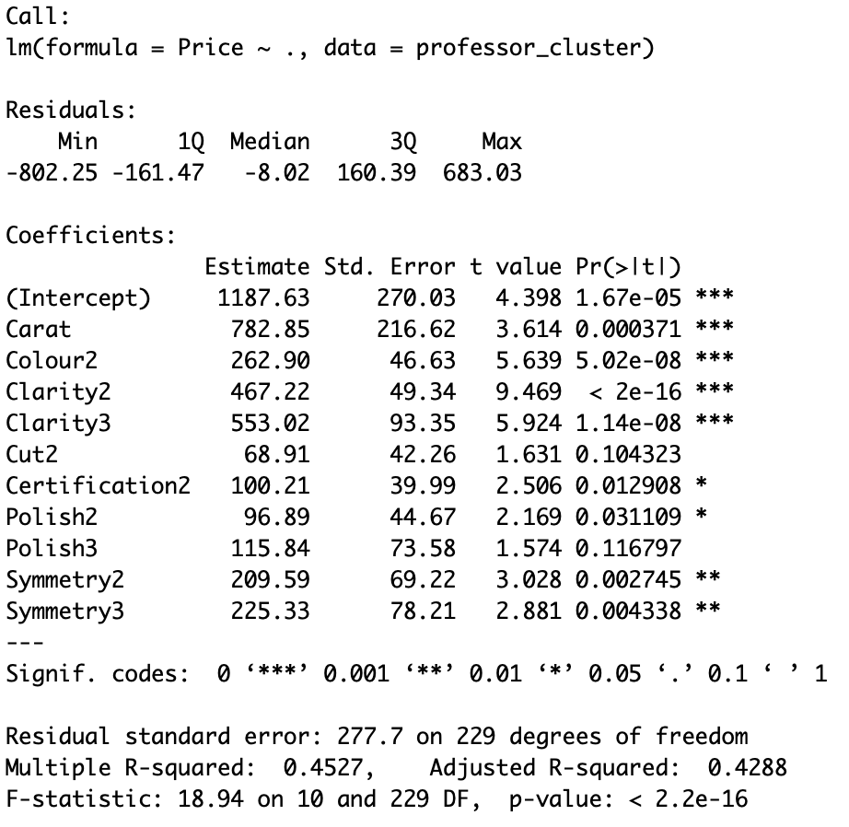
Model Selection
Variable Selection
Adjusted R² increased from 42.65% to 42.88%
Regroup Polish into 2 groups
Fair, Good – 1
Very Good, Excellent, Ideal – 2

Slide 36
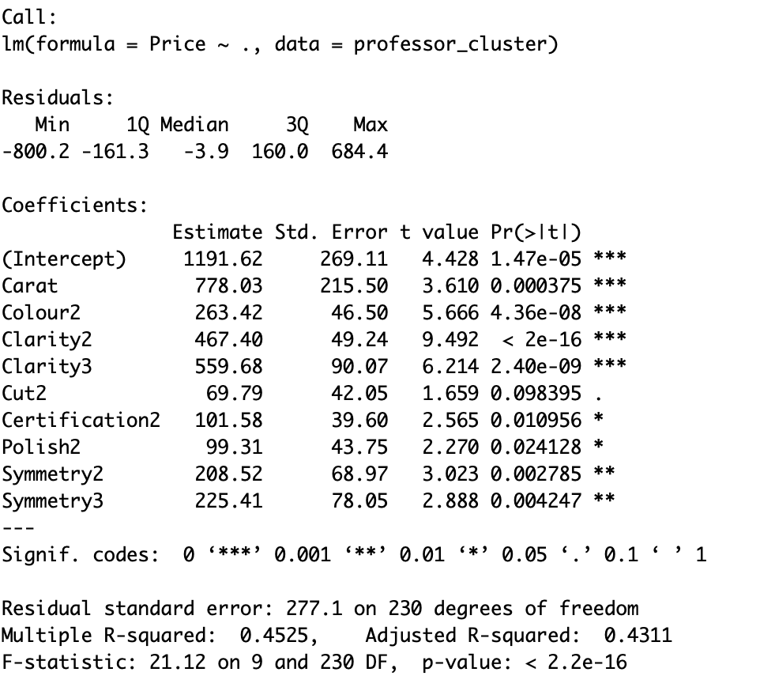
Model Selection
Variable Selection
Cut is not significant
Remove Symmetry

Slide 37
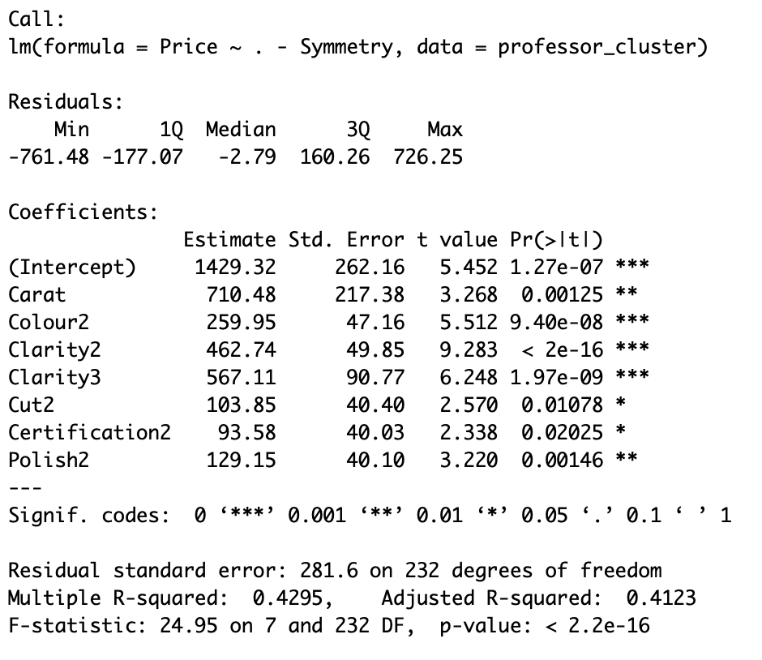
Model Selection
Variable Selection
All variables are significant
Colour has two groups only
Ungroup colour

Slide 38
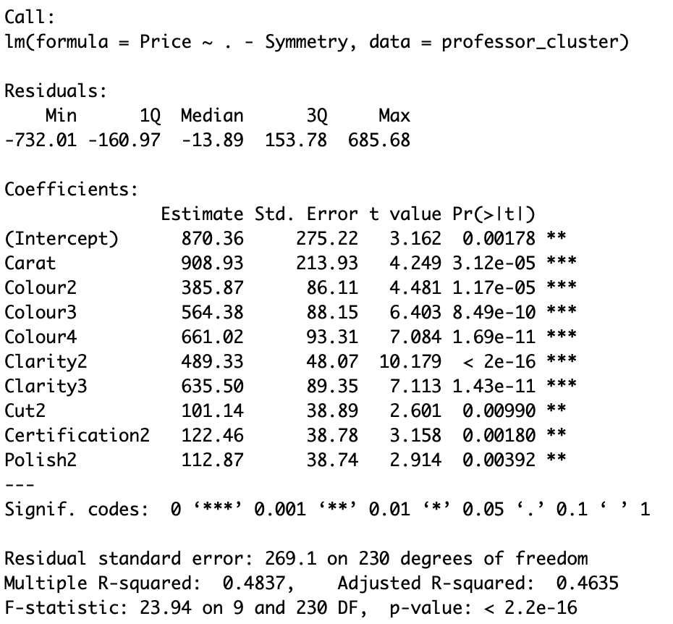
Model Selection
Variable Selection
Significant model with highest R²

Slide 39
Conclusion

Slide 40
Conclusion
Final Pricing Model for Diamond
Professor’s Diamond Engagement Ring
Carat Weight | 0.9
Cut | Very Good
Color | J
Clarity | SI2
Polish | Good
Symmetry | Very Good
Certification | GIA
[Quoted] Price | $3,100
Variable | Coefficient | Condition
Carat | 908.93
Colour2 | 385.87 | J-K – 1 Else – 0
Colour3 | 564.38 | G-I – 1 Else – 0
Colour4 | 661.02 | D-F - 1 Else – 0
Clarity2 | 489.33 | SI1, SI2,SI3 – 1 Else – 0
Clarity3 | 635.50 | VS1, VS2, VVS1, VVS2 – 1 Else – 0
Cut2 | 101.14 | Very Good, Excellent, Ideal – 1 Else – 0
Certification2 | 122.46 | AGS, GIA – 1 Else – 0
Polish2 | 112.87 | Very Good, Excellent, Ideal – 1 Else – 0
Intercept | 870.36
Price based on the model = $2,787.20
Difference = $312.80

Slide 41
THANK YOU!

